Slide 1
🧙‍♀️ Mage &
🏎️ DTC Zoomcamp
💫 Making Orchestration Magical with Mage

Slide 2
What is Mage?

Slide 3
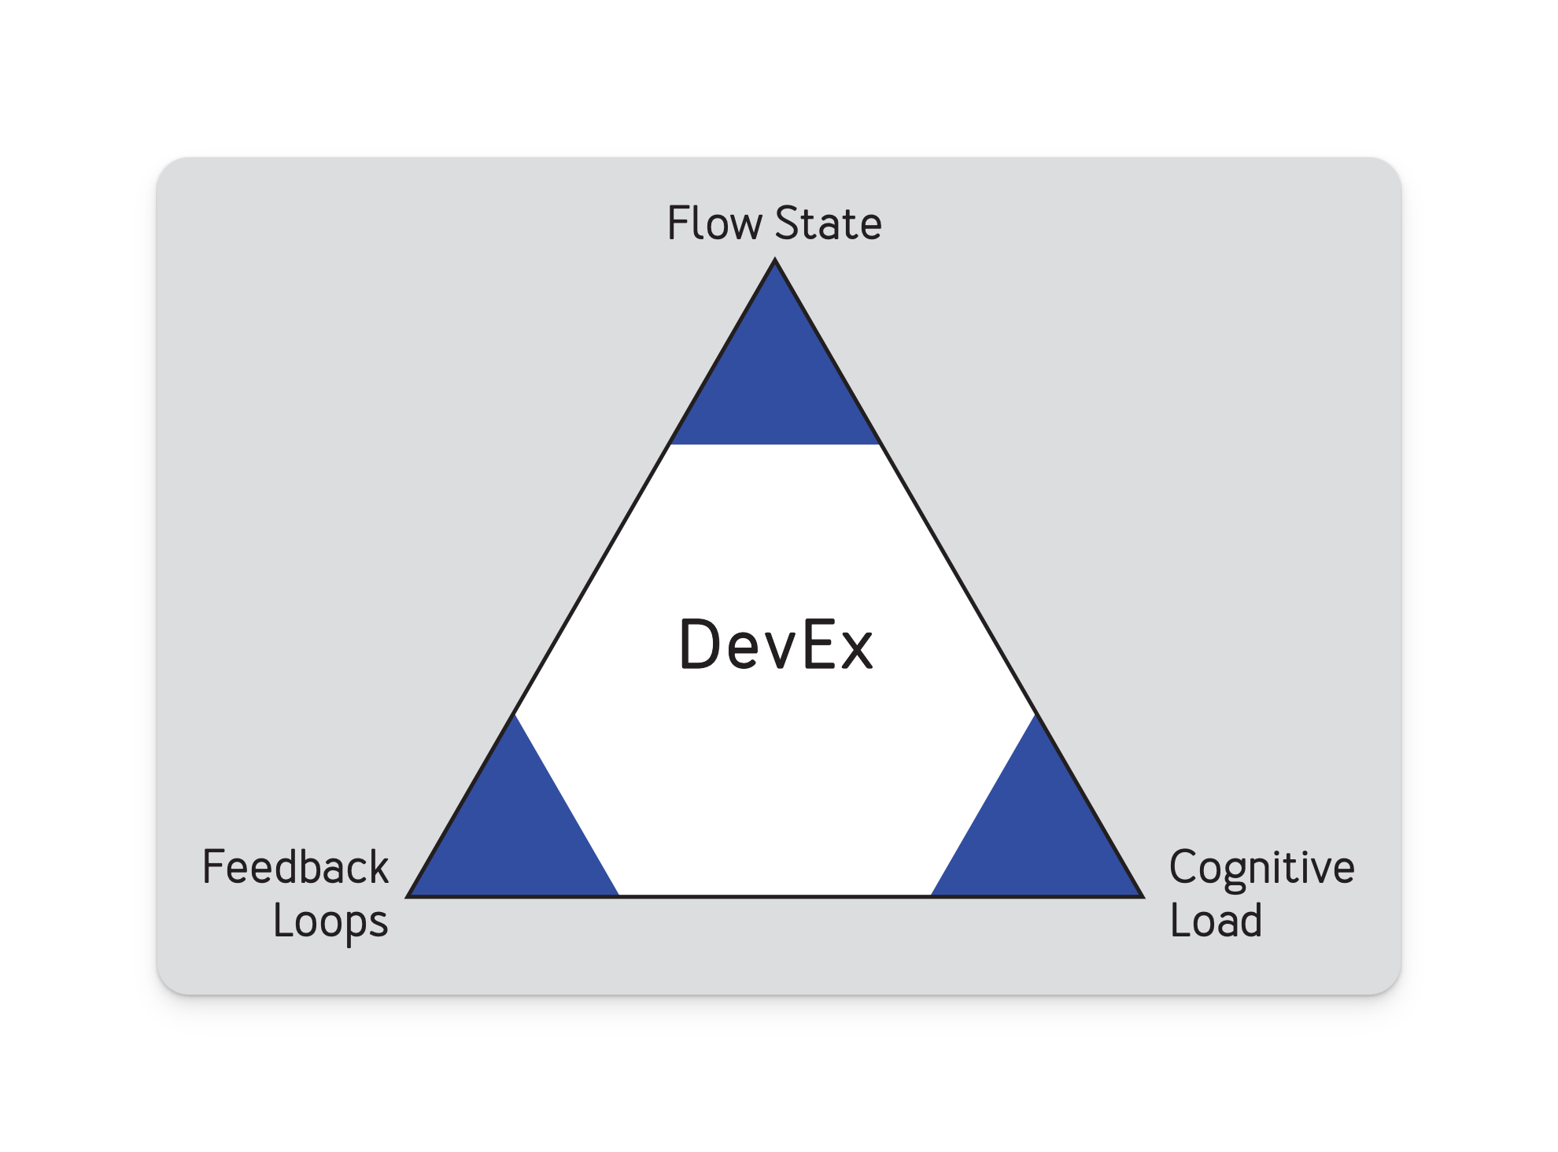

A good orchestrator prioritizes….
The developer experience
Flow state 🌊
“I need to switch between 7 tools/services.”
Feedback Loops 🔁
“I spent 5 hours locally testing this DAG.”
Cognitive Load 🧱
How much do you need to know to do your job?

Slide 4
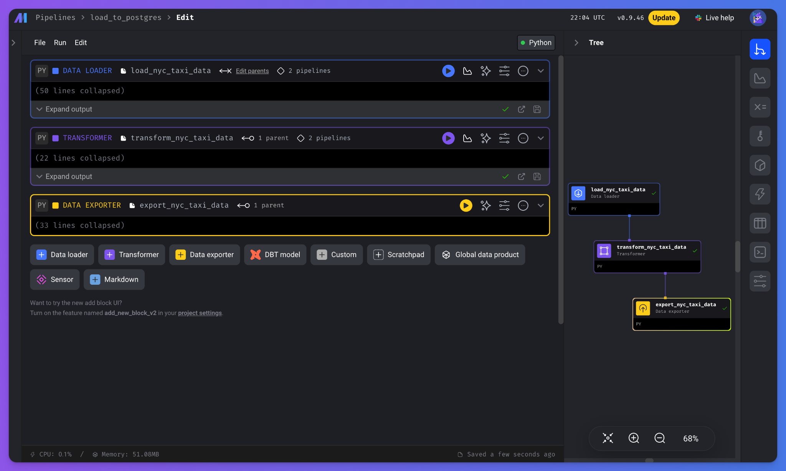
What is Mage?
An open-source pipeline tool for orchestrating, transforming, and integrating data 👷🏼‍♂️

Slide 5

👀 Sensors
👨🏻‍🔧 Data Integration
🏠 Projects
🧪Conditionals
🤝 Unified Pipelines
👨‍👩‍👧‍👦 Dynamics
🏗️ Pipelines
👯‍♂️ Multi-user envs
🪝 Webhooks
✍️ Templating
🧱 Blocks
🔨 Load
👷🏻‍♂️ Transform
⚙️ Export
🤯

Slide 7
🚀 Mage accelerates pipeline development
Hybrid environment
Use our GUI for interactive development (or don’t, I like VSCode)
Use blocks as testable, reusable pieces of code.
Improved DevEx
Code and test in parallel.
Reduce your dependencies, switch tools less, be efficient.

Slide 8
👨🏻‍💻 Engineering best-practices built-in
🧪 In-line testing and debugging
Familiar, notebook-style format
🔎 Fully-featured observability
Transformation in one place: dbt models, streaming, & more.
🏜️ DRY principles
No more 🍝 DAGs with duplicate functions and weird imports
DEaaS (sorry, I had to 😅)

Slide 9


Slide 10
Reduce time in undifferentiated work.

Slide 11

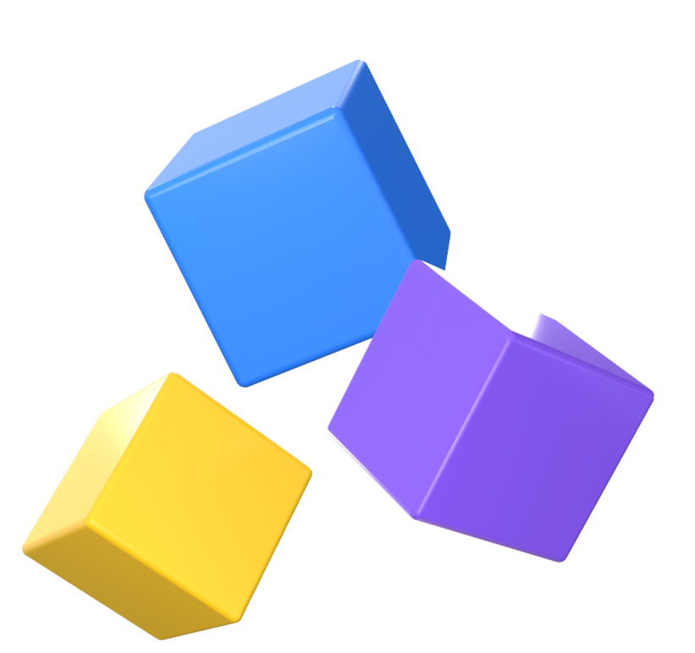
🏗️ Projects
🧪 Pipelines
🧱 Blocks

Slide 12
🏗️ Projects
A project forms the basis for all the work you can do in Mage— you can think of it like a GitHub repo.
It contains the code for all of your pipelines, blocks, and other assets.
A Mage instance has one or more projects

Slide 13
🧪 Pipelines
A pipeline is a workflow that executes some data operation— maybe extracting, transforming, and loading data from an API. They’re also called DAGs on other platforms
In Mage, pipelines can contain Blocks (written in SQL, Python, or R) and charts.
Each pipeline is represented by a YAML file in the “pipelines” folder of your project.

Slide 14
🧱 Blocks
A block is a file that can be executed independently or within a pipeline.
Together, blocks form Directed Acyclic Graphs (DAGs), which we call pipelines.
A block won’t start running in a pipeline until all its upstream dependencies are met.

Slide 15
🧱 Blocks continued
Blocks are reusable, atomic pieces of code that perform certain actions.
Changing one block will change it everywhere it’s used, but don’t worry, it’s easy to detach blocks to separate instances if necessary.
Blocks can be used to perform a variety of actions, from simple data transformations to complex machine learning models.

Slide 16
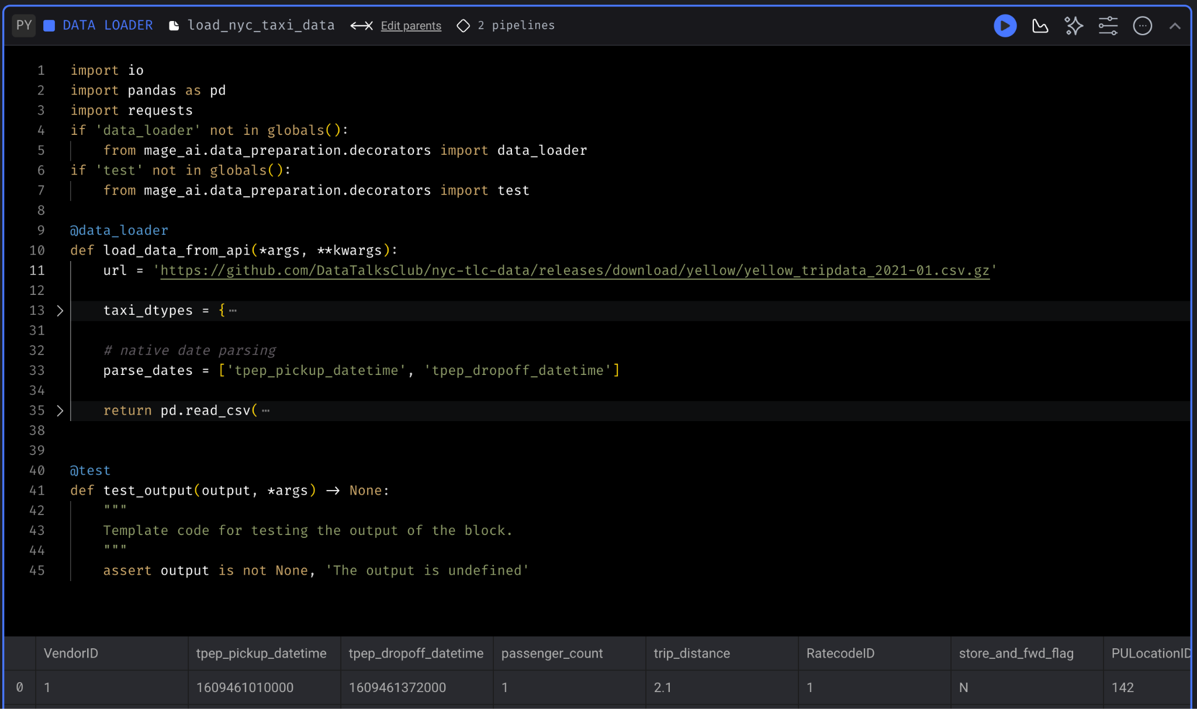
Anatomy of a Block
Imports
Decorator
Function*
Assertion
DataFrame
*returns df

Slide 17
Up next: Configuring Mage & running a pipeline

Slide 18
